Slide 1
Population Data Sources Overview
CalHHS Data Standards Community Meeting
October 2nd, 2023
Michael C. Samuel, DrPH
Jaspreet Kang
CDPH Office of Policy and Planning

Slide 2
Tentative Agenda
Introductions
Overview of big picture and key issues
Resources in progress
Summary table
Differences between data sources
(Pros/Cons document)
Detailed variables availability
Disaggregated race and ethnicity
Discussion/Questions

Slide 3
Population Data
Needed for all aspects of population health assessment
Denominators for rates, including adjusted rates
For life expectancy, and other measures
To describe population distributions
Essential for appropriate comparisons across population groups (i.e., “disparities”)
Need to be timely and accurate for comparisons to be meaningful
Common demographic variables needed include
year; sex; age; race and ethnicity; and geographic levels including counties, cities, and census tracts
Increasing need for population size data for disaggregated/detailed race and ethnicity, sexual orientation, and gender identity

Slide 4
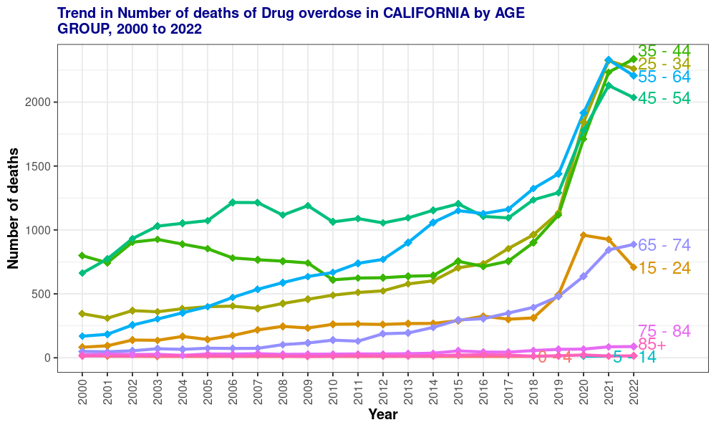
EXAMPLE: California Community Burden of Disease Engine
https://skylab.cdph.ca.gov/communityBurden

Slide 5
Key Data Sources
California Specific
California Department of Finance (DOF)
US Census
Decennial Census
Census “Vintage” Estimates
American Community Survey (ACS) – direct
American Community Survey (ACS) Public Use Microdata Sample (PUMS)
Other Federal Data
SEER
Commercial Data
ESRI
Claritas
No one data source meets all CDPH or LHJ needs

Slide 6
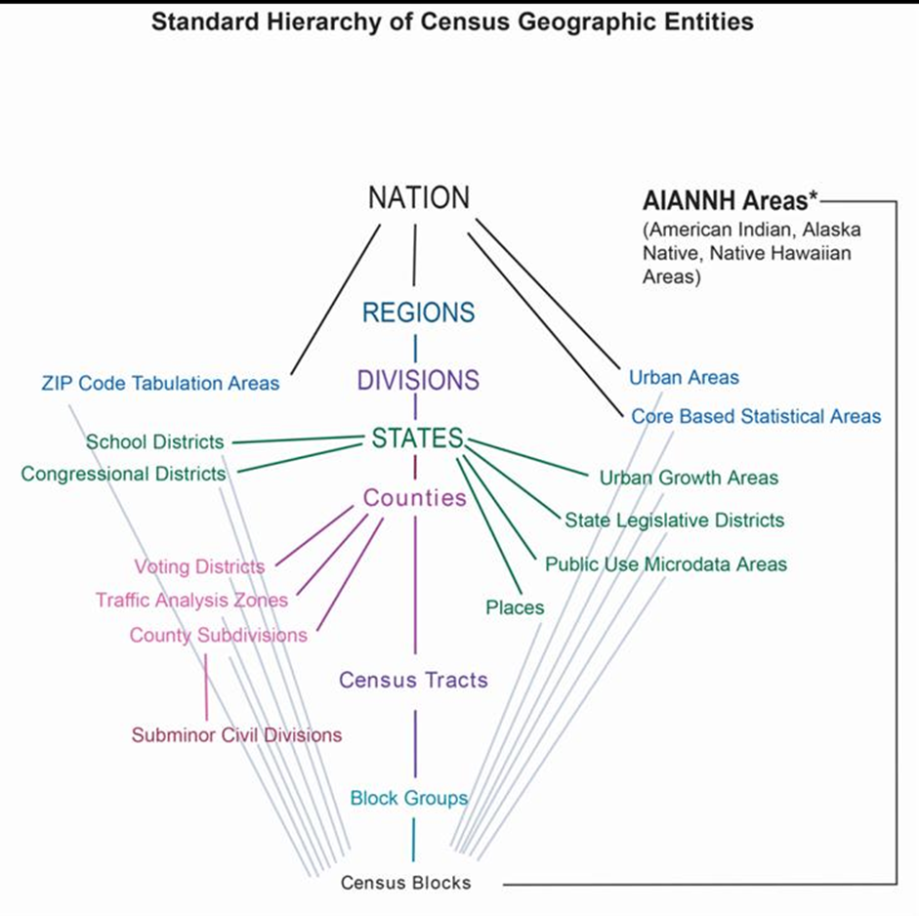
California Local Health Jurisdictions
Medical Service Study Areas (MSSAs)

Slide 7
Table of which sources have which needed data elements

Slide 8
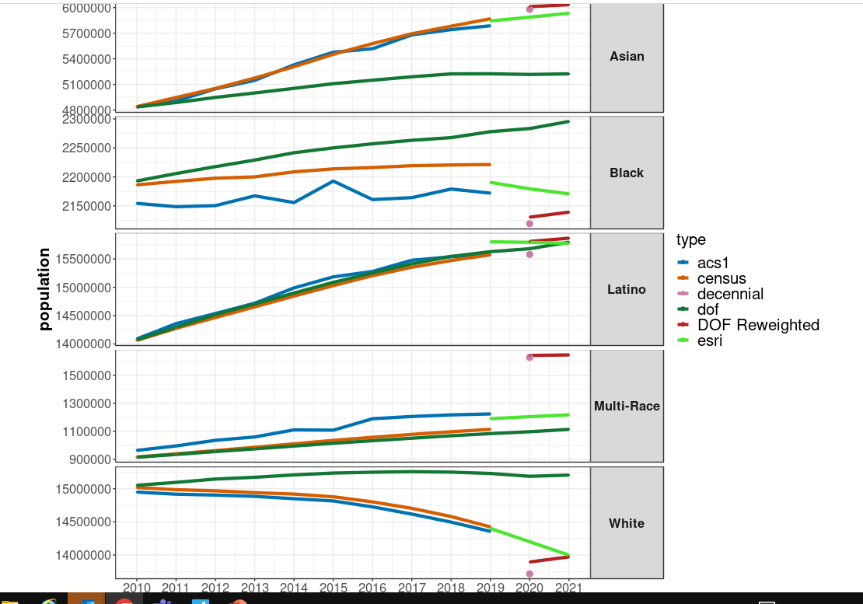
Issue: Estimates vary between sources. Which are most accurate?
DOF estimates generally are different from cluster of other estimates in several instances
Estimates differ more the further way from the decennial census year
All estimates use some of the same data inputs, so are not independent
In general, DOF overestimates White and Black numbers and underestimates Asians compared to other sources
https://skylab.dev.cdph.ca.gov/content/2711e60e-021b-43d2-b643-e67c9cebb5d3

Slide 9
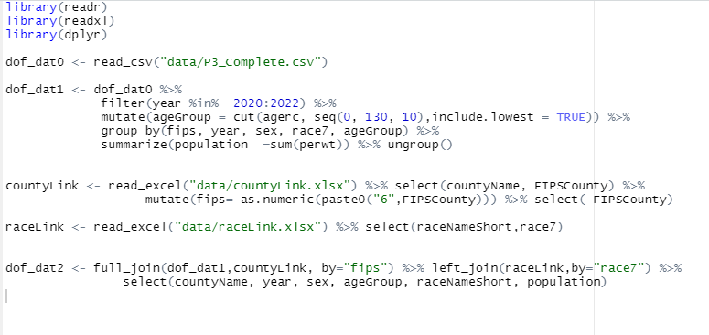
Accessing and Processing DOF Data

Slide 10
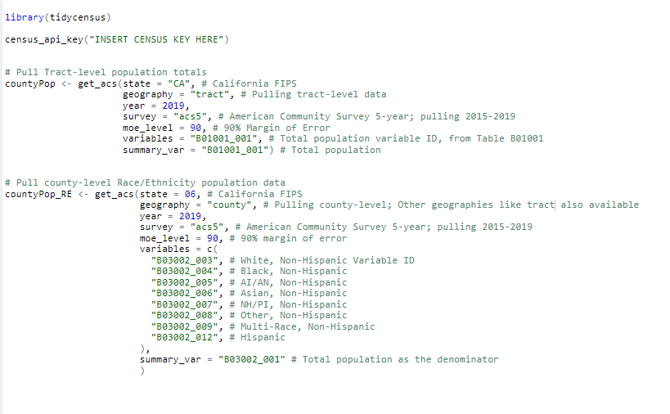
Accessing and Processing ACS Data using R

Slide 11

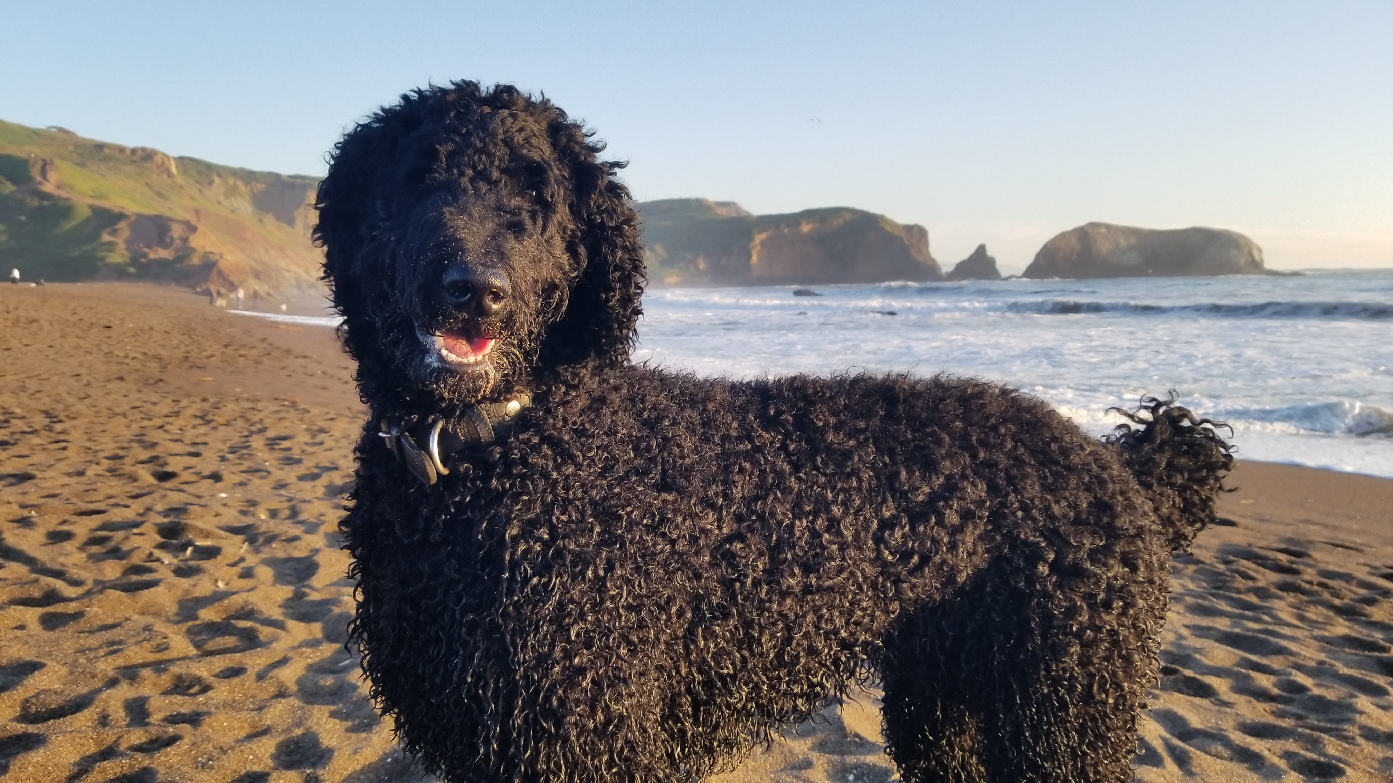
Discussion?
Michael.Samuel@cdph.ca.gov
JaspreetKang@cdph.ca.gov
ccb@cdph.ca.gov

Slide 12
Population Data Sources Overview
For:
Healthcare Analytics Branch
Information Services Division
Department of Health Care Access and Information (HCAI)
October 10th, 2022
Michael Samuel
Jaspreet Kang
CDPH Fusion Center/ Office of Policy and Planning

Slide 13
Tentative Agenda
Introductions (+/- 5 minutes)
Overview of big picture and key issues (+/- 10 minutes)
Data sources information table (+/- 10 minutes)
Accessing Department of Finance Data (+/- 10 minutes)
Accessing American Community Survey Data (+/- 10 minutes)
Discussion (+/- 10 minutes)

